Slide 1



Probabilistic Programming for Embedding Theory and Quantifying Uncertainty in Econometric Analysis
Thomas Heckeleiª
together with Hugo Stormª, Kathy Baylis^{b}
Keynote, XVII EAAE Congress 2023 Rennes
ªUniversity of Bonn, ^{b}University of California Santa Barbara

Slide 2

Time of debate and methodological advances
Debate on statistical malpractice and publication bias
Literature suggests change of reporting rules, better training, “mindful” statistical analysis, solid theoretical basis, … (Heckelei et al. 2023, Gigerenzer 2004, 2018)
Data science and algorithmic advances with potential to expand the econometricians’ toolbox (Storm et al. 2020; Athey, Imbens 2019)
© adobe stock

Slide 3

What I’d like to get to today
Bayesian inference is intuitive and naturally embeds uncertainty - time to become Bayesian econometricians
New algorithms and programming languages give rise to
Probabilistic Programming
semi-automatic Bayesian inference
explicit data generation process rigorously connects theory & inference
flexible inclusion of machine learning tools in causal identification setting
© adobe stock

Slide 4
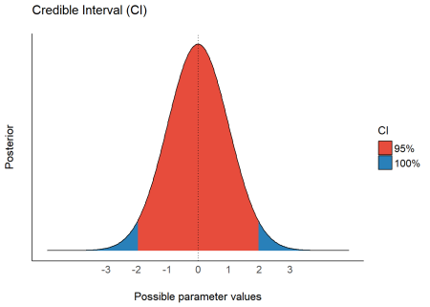
Bayesian statistical inference - an intuitive treat
Bayesian analysis offers an intuitive alternative to frequentist inference
The posterior distribution summarizes the available information on a parameter of interest including uncertainty
It allows a direct probabilistic interpretation
source: easystats
Given model assumptions, the probability that the true parameter value is between -2 and +2 is equal to 95%

Slide 5

What is the posterior (distribution)?
Remember: the likelihood is mathematically identical to the sampling distribution
direct link to the Data Generation Process (DGP)
Ignore the choice of the prior for now

Slide 6
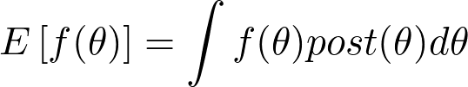
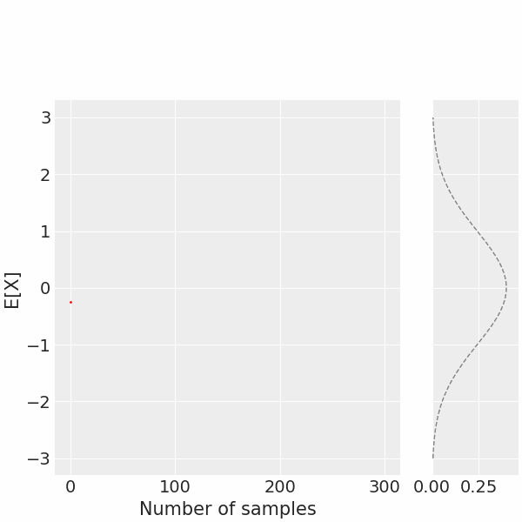
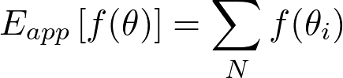
Sampling from the posterior allows statistical inference
can be approximated arbitrarily closely with a sample of size N as
posterior mean or variance
probability to lie within interval
…

Slide 7
Sampling from the posterior allows statistical inference
If you can sample from the posterior, any desirable inference is straightforward
Sample enough outcomes and calculate function of interest
posterior distributions and expectations of functions of model parameters
We would perhaps already be all Bayesians if it always worked…

Slide 8
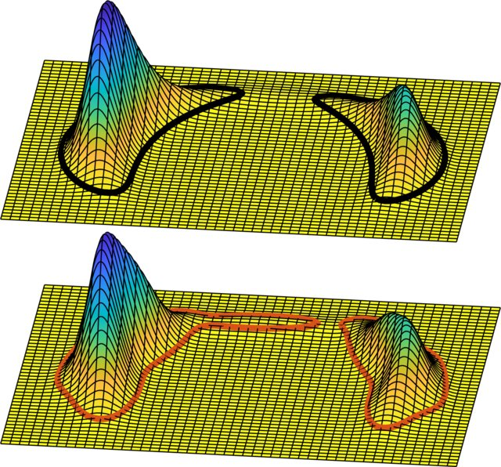
Why is the Bayesian approach not generally used?
Sampling from posterior often not straightforward or even possible for flexible prior and likelihood
Case-specific approaches had to be developed in the past
Convergence can be a nightmare and technical skill requirements are high
And more: Lack of training … derivation of likelihood can be hard…
Markov Chain Monte Carlo (MCMC)
Metropolis Hastings
Gibbs sampling
Stochastic Variational Inference (SVI)
Frisch and Hanebeck, 2020

Slide 9

New algorithms and programming languages can help
Advances of MCMC and SVI make case-specific posterior inference procedures unnecessary
New programming languages allow posterior inference based on the explicit formulation of the DGP
Probabilistic Programming
© adobe stock

Slide 10
Literature on Probabilistic Programming (PP)
“There are several reasons why probabilistic programming could prove to be revolutionary for machine intelligence and scientific modelling (...).
First, (...) obviates the need to manually derive inference methods for models (…). Second, (…) since it allows for rapid prototyping and testing of different models of data.”
Ghahramani 2015, p.455
“Probabilistic programming is about doing statistics using the tools of computer science.”
Meent et al. 2018, p.21

Slide 11
Intuition on PP (Adapted from Meent et al. 2018, p.22)
Computer
Science
Parameters
Program
Output

Slide 12
Intuition on PP (Adapted from Meent et al. 2018, p.22)
Computer
Science
Statistics
Inference
Parameters
Posterior / Estimates
Program
Statistical Model
Output
Observations

Slide 13
Intuition on PP (Adapted from Meent et al. 2018, p.22)
Computer
Science
Probabilistic Programming
Statistics
Inference
Parameters
Parameters
Posterior / Estimates
Program
Program
Statistical Model
Output
Observations
Observations

Slide 14

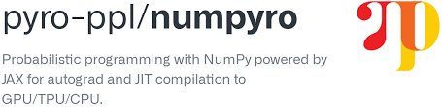




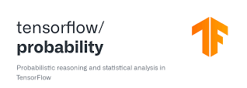
PP eco-system
Frameworks
Diagnosis and Visualization
GPU support, auto-diff, and more

Slide 15
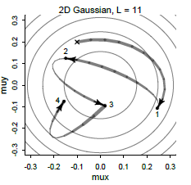
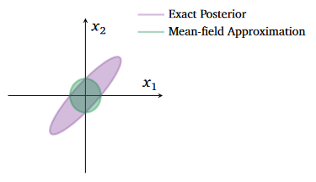
New automatic Bayesian inference algorithms
Hamiltonian Monte Carlo inference, using No U-Turn Sampler (NUTS)
MCMC samples with no/minimum hyperparameter tuning
Large speed gain by running on GPU (using JAX gradients)
Allows larger models and samples sizes (compared to old MCMC)
Stochastic Variational Inference (SVI)
Approximate posterior inference
much(!) faster than MCMC
can deal with very large number of parameters and sample sizes
McElreath 2020
Blei et al. 2017

Slide 16
Linear regression in PP (using NumPyro)
DGP is defined as a function
def model(X,Y=None):
b = numpyro.sample('b',dist.Normal(0,1).expand([X.shape[1]]))
sigma = numpyro.sample('sigma', dist.Exponential(1))
numpyro.sample('Y',dist.Normal(X @ b,sigma), obs=Y)
Regression Coef
Variance of Errors

Slide 17
Linear regression in PP (using NumPyro)
DGP is defined as a function
Prior distributions
def model(X,Y=None):
b = numpyro.sample('b',dist.Normal(0,1).expand([X.shape[1]]))
sigma = numpyro.sample('sigma', dist.Exponential(1))
numpyro.sample('Y',dist.Normal(X @ b,sigma), obs=Y)
Regression Coef
Variance of Errors
Distribution of Y
Mean of Y = Xb

Slide 18
Linear regression in PP (using NumPyro)
Allows switching between generative and inference mode
DGP is defined as a function
Prior distributions
def model(X,Y=None):
b = numpyro.sample('b',dist.Normal(0,1).expand([X.shape[1]]))
sigma = numpyro.sample('sigma', dist.Exponential(1))
numpyro.sample('Y',dist.Normal(X @ b,sigma), obs=Y)
Regression Coef
Variance of Errors
Distribution of Y
Conditioning statement
Mean of Y = Xb

Slide 19
Logit model in PP (using NumPyro)
Linear regression
def model(X,Y=None):
b = numpyro.sample('b',dist.Normal(0,1).expand([X.shape[1]]))
sigma = numpyro.sample('sigma', dist.Exponential(1))
numpyro.sample('Y',dist.Normal(X @ b,sigma), obs=Y)
Logit model
def modelLogit(X,Y=None):
b = numpyro.sample('b', dist.Normal(0,1).expand([X.shape[1]]))
numpyro.sample('Y',dist.Bernoulli(logits=X @ b), obs=Y)
Bernoulli distribution with logit link function

Slide 20
Example 1 - predict winter wheat yield
regional average yields, N = 148 (taken from Pahmeyer 2021)
Prior sampling: use of generative model to test model and priors:
Add a normal (b ~ N(0,1)) prior on coefficients (for normalized variables)
Sample from the prior distribution of parameters
Generate and plot predicted yields for prior sample

Slide 21
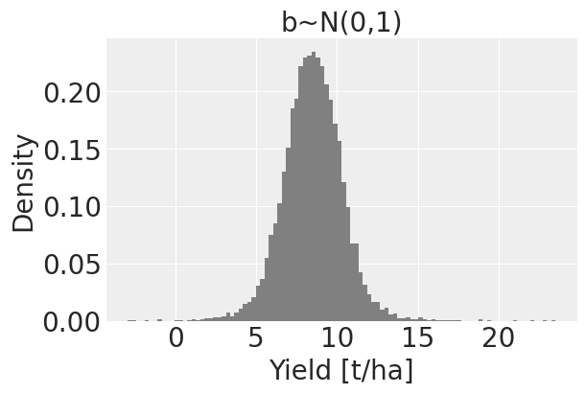
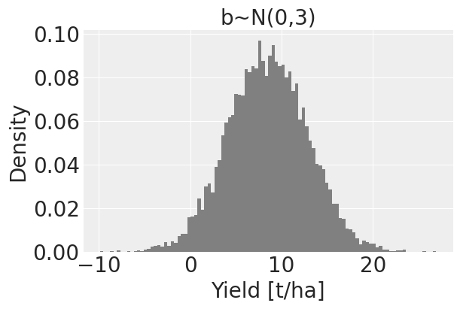
Prior sample outcomes of winter wheat yield
Prior yields

Slide 22
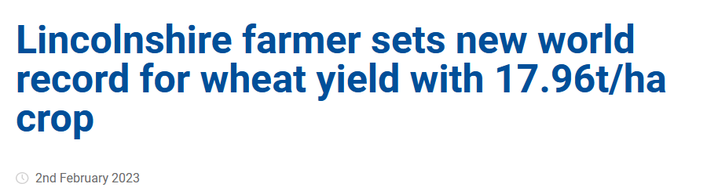
Prior sample outcomes of winter wheat yield
Prior yields
farmersguide.co.uk

Slide 23
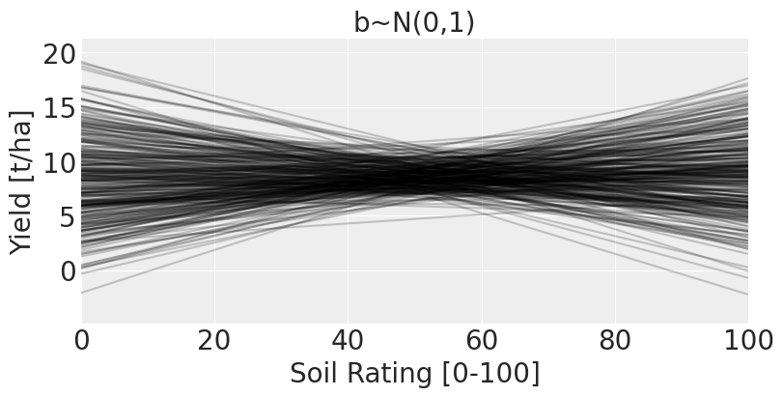
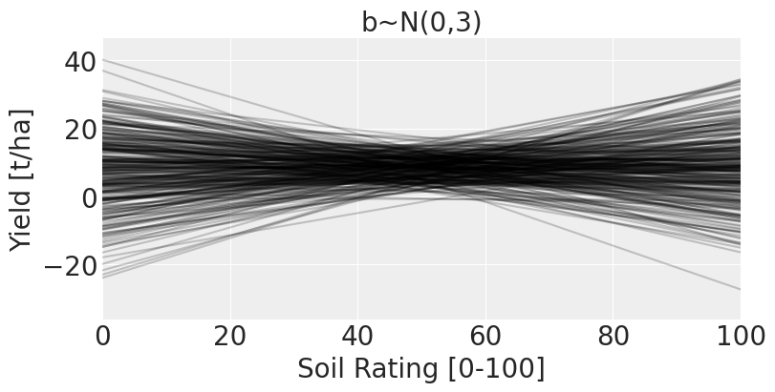
Prior sample outcomes of winter wheat yield
Prior yields
Prior regression lines

Slide 24
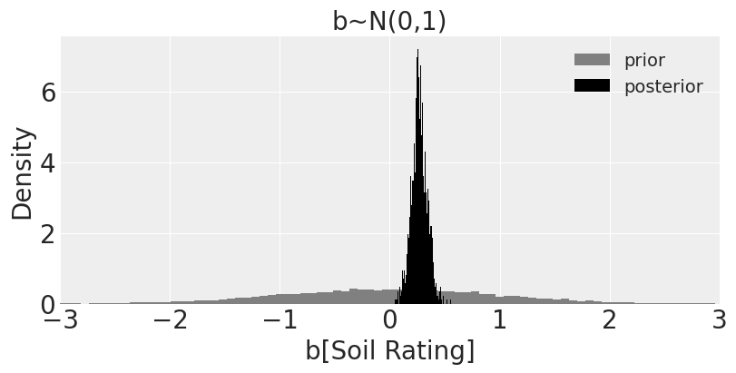
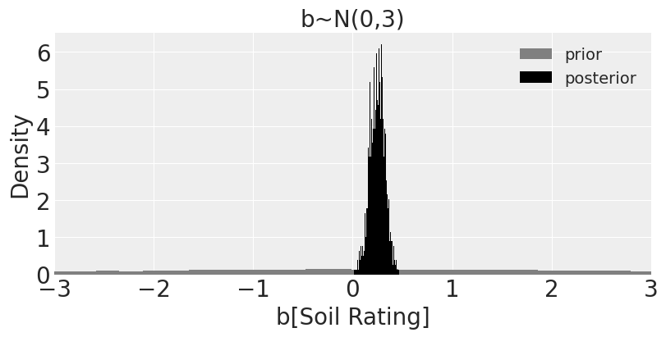
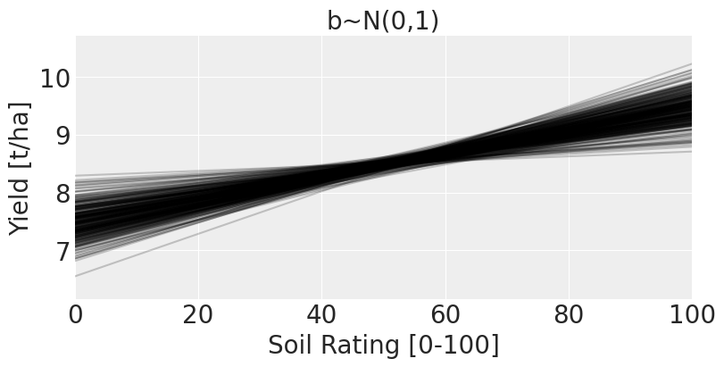

Inference mode: deriving posterior of coefficient(s)
Posterior (and prior)
Posterior regression lines

Slide 25
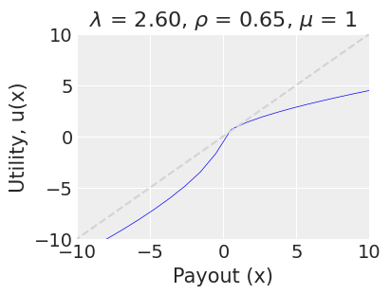
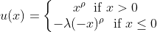
Example 2 - Cumulative prospect theory model
Game: Choose between 50/50 gamble
or payout with certainty
Building on: www.thegreatstatsby.com

Slide 26
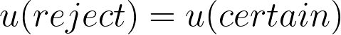
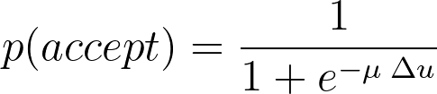
Example 2 - Cumulative prospect theory model
Game: Choose between 50/50 gamble
or payout with certainty
Building on: www.thegreatstatsby.com

Slide 27
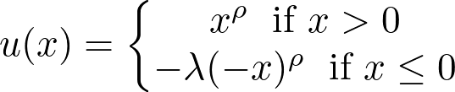
Cumulative prospect theory model: PP implementation
def utility(x, lam, rho):
...
def model_PT(gain, loss, cert, took_gamble=None):
# Define priors
lam = numpyro.sample('lam', dist.TruncatedNormal(loc=2, scale=1.0,low=1., high=4.))
rho = numpyro.sample('rho', dist.TruncatedNormal(loc=1, scale=1.0,low=0.5, high=1.))
mu = numpyro.sample('mu', dist.Uniform(0.5, 1.5))
# Calculate utility of gamble and certain option
util_reject = utility(cert, lam, rho)
util_accept = 0.5 * utility(gain, lam, rho) + 0.5 * utility(loss, lam, rho)
util_diff = util_accept - util_reject
# Calculate probability of accepting gamble
p_accept = 1/(1+jnp.exp(-mu*util_diff))
# Choice to take gamble
numpyro.sample('took_gamble', dist.BernoulliProbs(p_accept), obs=took_gamble)
Building on: www.thegreatstatsby.com

Slide 28
Cumulative prospect theory model: PP implementation
Definition of prior distributions including restrictions to theoretically plausible ranges
def utility(x, lam, rho):
...
def model_PT(gain, loss, cert, took_gamble=None):
# Define priors
lam = numpyro.sample('lam', dist.TruncatedNormal(loc=2, scale=1.0,low=1., high=4.))
rho = numpyro.sample('rho', dist.TruncatedNormal(loc=1, scale=1.0,low=0.5, high=1.))
mu = numpyro.sample('mu', dist.Uniform(0.5, 1.5))
# Calculate utility of gamble and certain option
util_reject = utility(cert, lam, rho)
util_accept = 0.5 * utility(gain, lam, rho) + 0.5 * utility(loss, lam, rho)
util_diff = util_accept - util_reject
# Calculate probability of accepting gamble
p_accept = 1/(1+jnp.exp(-mu*util_diff))
# Choice to take gamble
numpyro.sample('took_gamble', dist.BernoulliProbs(p_accept), obs=took_gamble)
Building on: www.thegreatstatsby.com

Slide 29
Cumulative prospect theory model: PP implementation
Definition of prior distributions including restrictions to theoretically plausible ranges
def utility(x, lam, rho, mu):
...
def model_PT(gain, loss, cert, took_gamble=None):
# Define priors
lam = numpyro.sample('lam', dist.TruncatedNormal(loc=2, scale=1.0,low=1., high=4.))
rho = numpyro.sample('rho', dist.TruncatedNormal(loc=1, scale=1.0,low=0.5, high=1.))
mu = numpyro.sample('mu', dist.Uniform(0.5, 1.5))
# Calculate utility of gamble and certain option
util_reject = utility(cert, lam, rho)
util_accept = 0.5 * utility(gain, lam, rho) + 0.5 * utility(loss, lam, rho)
util_diff = util_accept - util_reject
# Calculate probability of accepting gamble
p_accept = 1/(1+jnp.exp(-mu*util_diff))
# Choice to take gamble
numpyro.sample('took_gamble', dist.BernoulliProbs(p_accept), obs=took_gamble)
Sampling statement for accept / reject decision
Building on: www.thegreatstatsby.com

Slide 30
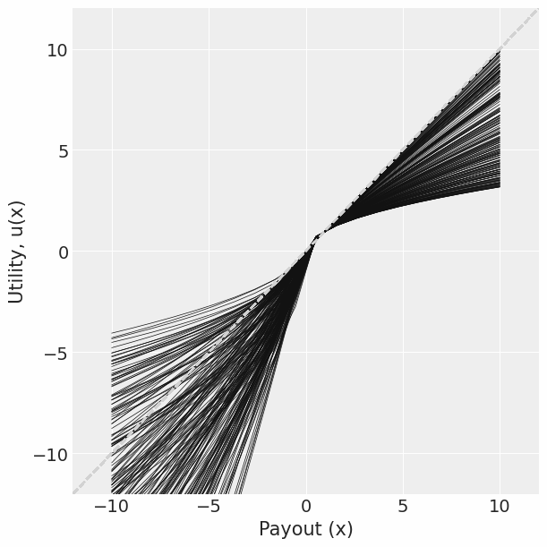
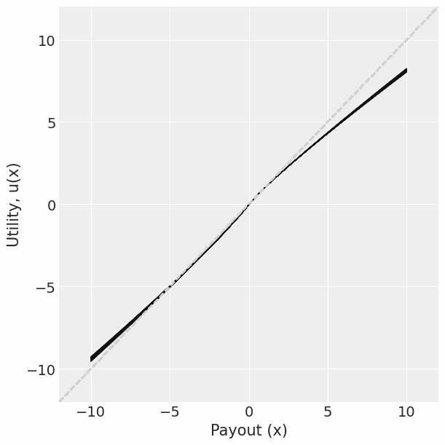
Cumulative prospect theory model - prior vs. posterior
Prior utility functions
Posterior utility functions
Building on: www.thegreatstatsby.com

Slide 31
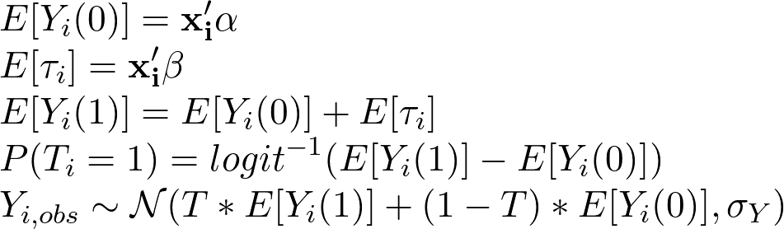
Example 3 - Potential outcome framework (Imbens 2020)
Heterogeneous treatment effects depending on X
Selection into treatment based on expected treatment effect
Expected outcome without treatment
Expected (linear) treatment effect
Expected outcome with treatment
Probability of treatment
Distribution of Y

Slide 32
Example 3 - Potential outcome framework
Heterogeneous treatment effects depending on X
Selection into treatment based on expected treatment effect
Expected outcome without treatment
Expected (linear) treatment effect
Expected outcome with treatment
Probability of treatment
Distribution of Y

Slide 33
Potential outcome framework - PP implementation
def modelPotOutcome(X, T=None, Y=None):
alpha = numpyro.sample("alpha", dist.Normal(0.,1).expand([X.shape[1]]))
beta = numpyro.sample("beta", dist.Normal(0.,1).expand([X.shape[1]]))
sigma_Y = numpyro.sample("sigma_Y", dist.Exponential(1))
EY0 = X @ alpha
Etau = X @ beta
EY1 = Y0 + tau
T = numpyro.sample("T", dist.Bernoulli(logits=Y1 - Y0), obs=T)
numpyro.sample("Y", dist.Normal(Y1*T + Y0*(1-T), sigma_Y), obs=Y)
Prior distributions on
𝝰, 𝝱, 𝞂

Slide 34
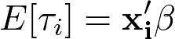
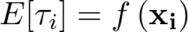
Non-linear treatment effects
Straightforward in PP to replace linear effect with non-linear functions
Those might even be flexible deep Neural Networks (includes training with dropout, batch learning, flexible number of layer/neurons)

Slide 35
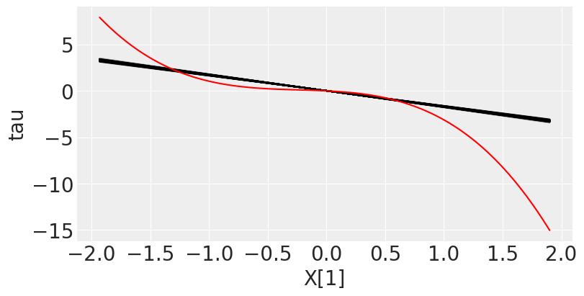
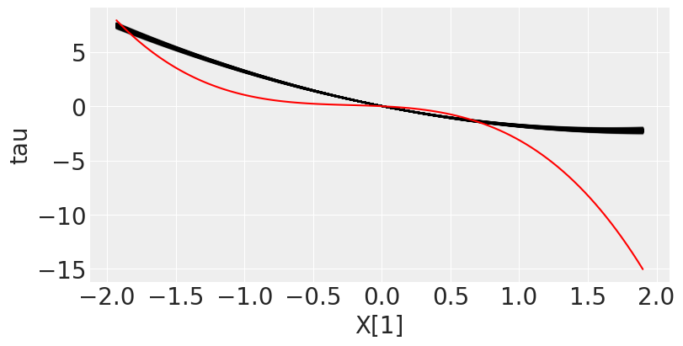
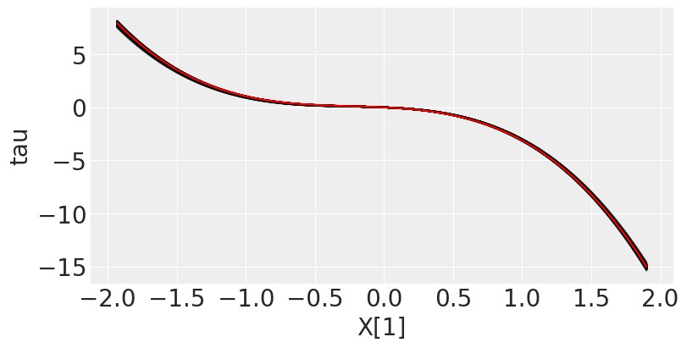
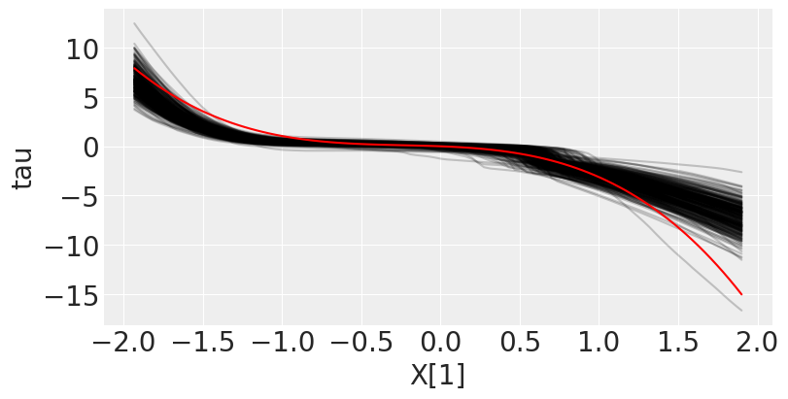
Knowing the functional form always helps, but…
True model is a cubic treatment effect (red line)
Linear treatment model
Squared treatment model
Limited functional form flexibility with potentially large errors
Knowing the functional form is best, but if we don’t, ML techniques can be very useful
Cubic treatment model
“Deep” MLP treatment model

Slide 36
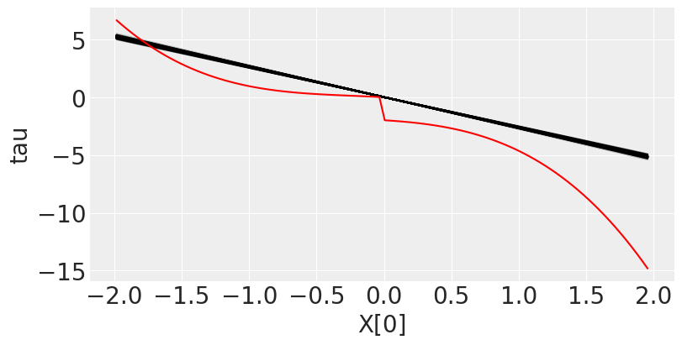
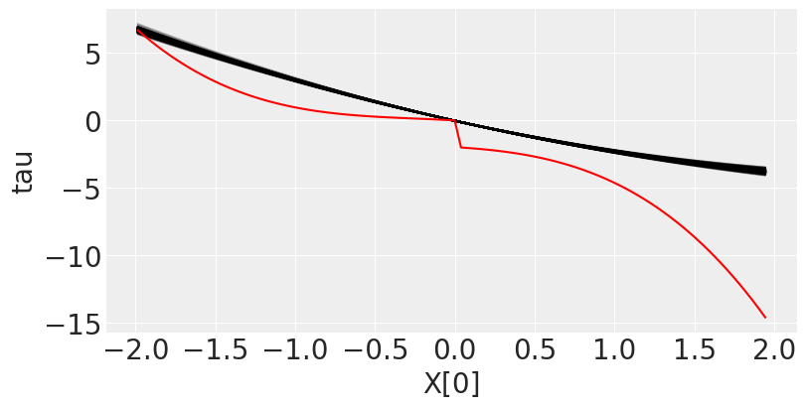
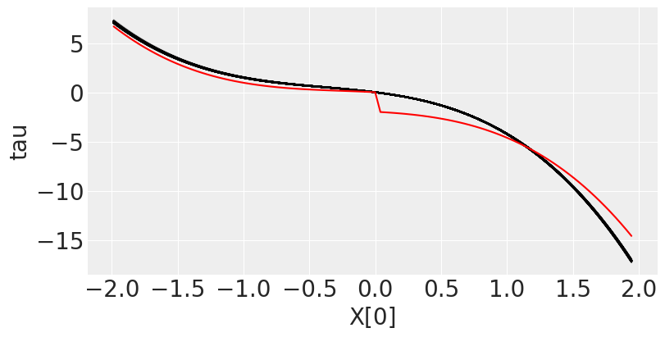
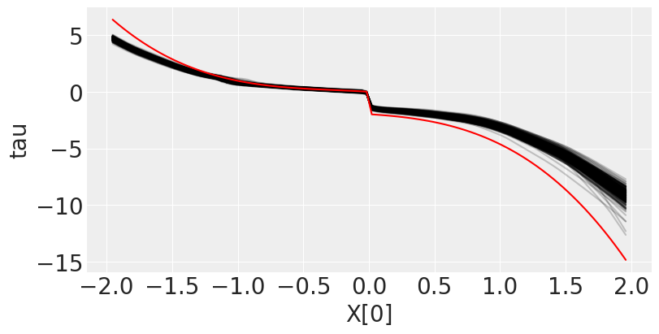
And even more non-linear treatment
True model is a cubic treatment effect with a step function (red line)
Linear treatment model
Squared treatment model
ML techniques can be quite amazing - here as part of a statistical, causal identification framework
Cubic treatment model
“Deep” NN (MLP) treatment model

Slide 37
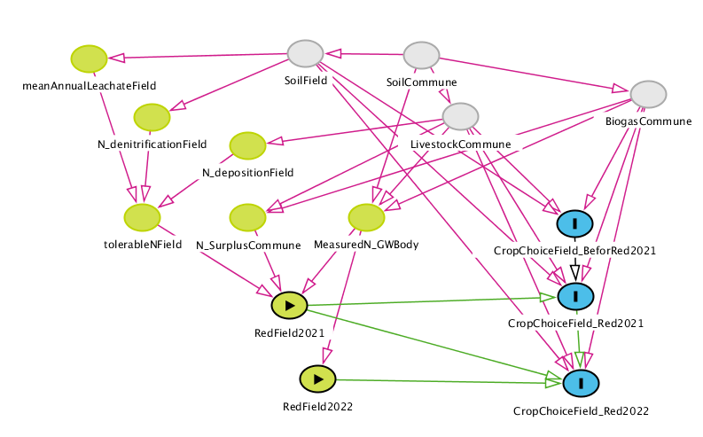
Some additions on explicit formulation of DGPs
More complex, individual data generating processes can be addressed with PP
Raises awareness of identification issues
Allows model testing and comparison
In preparation, it made us unexpectedly think about the source of uncertainty in ‘standard’ models as well
Kuhn et al. 2023

Slide 38

Take home messages, code, poster
Bayesian statistical analysis offers intuitive inference directly reflecting uncertainty
Advances facilitate semi-automatic Bayesian analysis via Probabilistic Programming
Explicitly formulating a generative model helps us to focus on the economics
…and fosters statistical inference embedded in a holistic research design process
Machine learning tools can contribute most to Econometrics in causal frameworks
We need updating of econometrics curricula
https://github.com/hstorm/pp_eaae_rennes
Go Bayesian!

Slide 39
References
Athey, S., Imbens, G.W. 2019. “Machine Learning Methods That Economists Should Know About”.Annual Review of Economics 11(1), 685-725.
Blei, D.M.,Kucukelbir, A.,McAuliffe, J.D.. 2017. “Variational Inference: A Review for Statisticians.” Journal of the American Statistical Association 112 (518): 859–77.
Frisch, D., Hanebeck, U. 2020. “Progressive Bayesian Filtering with Coupled Gaussian and Dirac Mixtures”. 1-8. http://dx.doi.org/10.23919/FUSION45008.2020.9190540.
Ghahramani, Z. 2015. “Probabilistic Machine Learning and Artificial Intelligence.” Nature 521 (7553): 452–59.
Gigerenzer G., 2004. “Mindless Statistics”:.The Journal of Socio-Economics 33(5), 587-606.
Gigerenzer G., 2018. “Statistical Rituals: The Replication Delusion and How We Got There”. Advances in Methods and Practices in Psychological Science. 2018;1(2):198-218. doi:10.1177/2515245918771329
Heckelei, T., Hüttel, S., Odening, M., Rommel, J. 2023: “The p-Value Debate and Statistical (Mal)practice - Implications for the Agricultural and Food Economics Community”. German Journal of Agricultural Economics 72(1), 47-67.
Imbens, G. W. 2020. "Potential Outcome and Directed Acyclic Graph Approaches to Causality: Relevance for Empirical Practice in Economics." Journal of Economic Literature, 58 (4): 1129-79.
Kuhn, T., Pahmeyer, C., Storm, H. 2023. “Using Probabilistic Programming to Assess Policy Induced Adaptation of Crop Choices: A Case Study of the German Implementation of the EU Nitrates Directive. Poster presented at the XVII Congress of the European Association of Agricultural Economists, Rennes
McElreath, R. 2020. “Statistical Rethinking: A Bayesian Course with Examples in R and Stan”. Chapman and Hall/CRC.
Meent, van de, J.-W, Paige, B., Yang,H., Wood, F. 2018. “An Introduction to Probabilistic Programming.” arXiv [stat.ML]. arXiv. http://arxiv.org/abs/1809.10756.
Pahmeyer, C. 2021. “Estimating plot specific yields”. https://observablehq.com/d/3a2dd11e01f67dfb
Stillman, P.R. 2021.”Estimating Prospect Theory Parameters with Maximum Likelihood in R. The Great Statsby, https://www.thegreatstatsby.com/posts/2021-03-08-ml-prospect/. .

